Slide 1

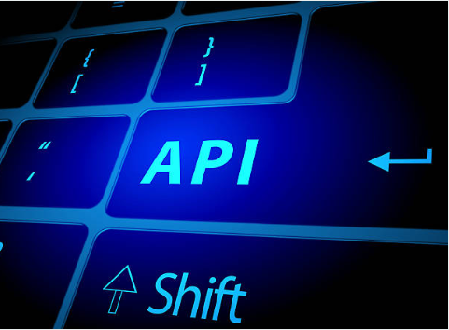
Acme Pharma
WorkDay AnyPoint Platform Integration Project
Steering Committee Meeting
25th November 2019
Tosin Adegbamigbe

Slide 2
Agenda
1
Background & Project Objectives
2
Project Scope
3
MuleSoft’s Approach & Service Offering
4
Solution Architecture
5
Project Timeline
6
Risks and Issues
7
Project Status Summary Dashboard
8
Decisions and Next Steps

Slide 3
Background and Project Objectives
Overall Project Objectives
Acme Pharma, is a Fortune 100 Pharmaceutical company and has been in business for many years, however they are now in a period where technology advancement is increasing daily and newer and smaller competitors are entering into the biotech industry.
Acme Pharma needs to stay competitive with these newer companies in cloud technology and enhance their supply chain model.
The integration of MuleSoft AnyPoint Platform along with the Workday migration will help Acme Pharma create a new IT operating model such as integrating with third party SaaS HCM applications (ADP, PeopleSoft, Taleo) within the Biotech industry.
Provide MuleSoft Catalyst Launch technology delivery services to assist Acme Pharma establish the MuleSoft AnyPoint Platform and deliver on the identified projects using API led approach.
Set up an internal support model to operate/manage MuleSoft,
Train Acme Pharma resources through MuleSoft product training and skills transfer.
Notes:
Should reflect information documented in the Project Charter

Slide 4
Project Scope
The completion of integration of the AnyPoint platform will result to the following benefits:
Platform Benefits: Adopting the API-led approach to achieve Acme Pharma's new IT operating model will help reduce the hours during the build and run phase of new HCM SaaS integration with third party HCM applications.
IT initiative: Will be delivered quicker and the delivery of business objective will be quicker therefor business value is received Sonner.
Business Outcomes: Based on the savings from the fewer hours spent on the development of fewer hours spent maintenance , more technology initiatives can be started that will drive sales productivity and make Acme Pharma stay competitive now and in the future
Catalyst Launch Delivery
AnyPoint Platform
Projects
Business Outcomes
Customer success plan
2
1
3
Organization Enablement
C4E Foundation
Internal Support Model
Talent Foundation

Slide 5
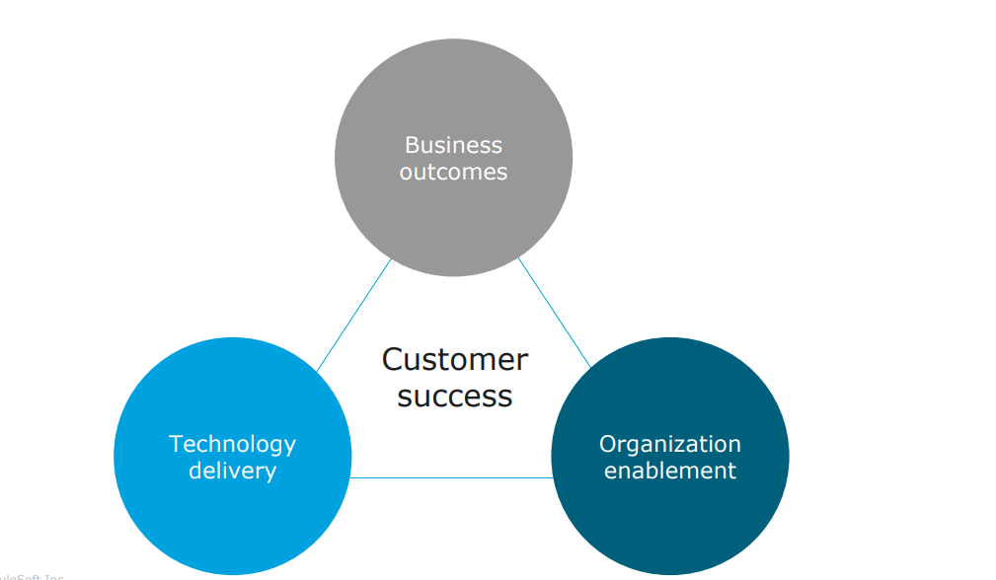
MuleSoft’s Approach & Service Offering
MuleSoft has a unique delivery approach to make projects successful and also shares our values. This approach is centered around three core pillars:
Notes:
Should reflect information documented in the Project Charter

Slide 6
Outcome Based Delivery Playbook
Plan
Design
Deploy/Transition
Measure
Key Activities
Agree on business outcomes and KPIs
Develop overall success plan
Monitor/Manage business reviews
Refresh success plans
Measure business outcomes
Business
Outcomes
Platform
Define AnyPoint platform vision and roadmap
Design AnyPoint platform architecture and implementation plan
Deploy AnyPoint platform
Refine and scale AnyPoint platform
Measure AnyPoint Platform KPIs
Technology
Delivery
Projects
Prioritize IT projects and quick wins
Staff and onboard project teams
Define reference architecture
Launch initial project and quick wins
Launch additional projects
Measure Project KPIs
C4E
Access integration capabilities
Establish the C4E operating model
Build and publish foundational assets
Evangelize
Drive Consumption
Measure C4E KPIs
Organizational
Enablement
Support/Train
Onboard MuleSoft
Agree on initial roles
Design internal support operating model
Develop training plan
Staff, Train and launch team
Launch experiential learning opportunities
Measure support KPIs
Conduct skills assessment

Slide 7
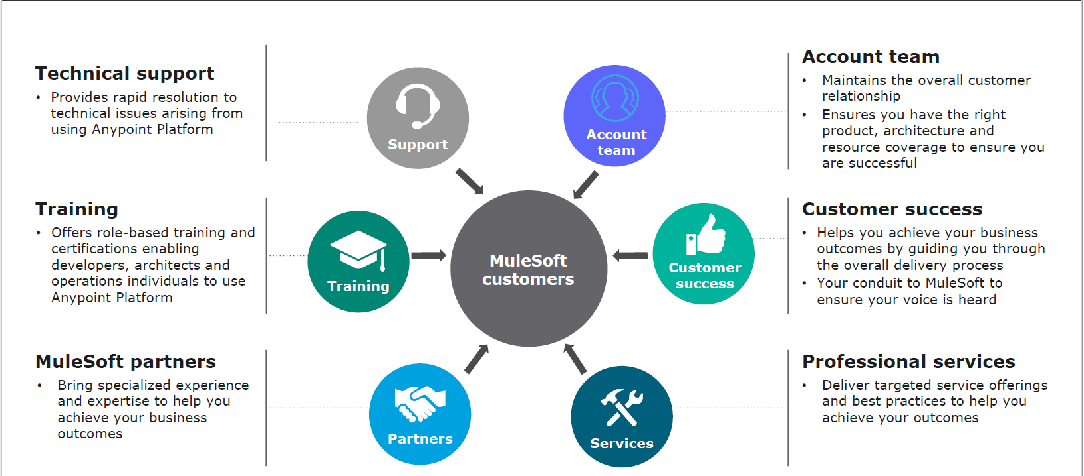
MuleSoft Team is here to help along this journey

Slide 8
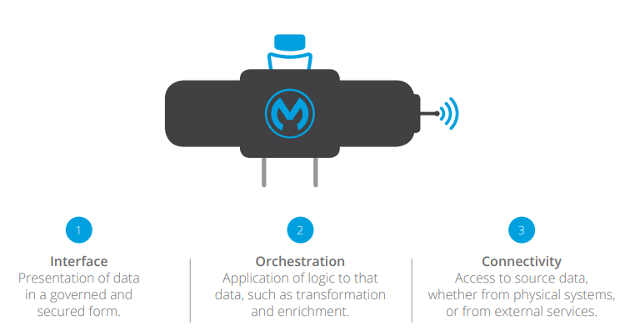
Solution Architecture
The MuleSoft AnyPoint platform is developed using the API-led connectivity:
Layer | Ownership | Frequency of Changes
System Layer | Central IT | 6 – 12 Months
Process Layer | Central IT and line of business IT | 3 – 6 Months
Experience Layer | Line of business IT and application developers | 4 – 8 Weeks; more frequently for more mature companies

Slide 9
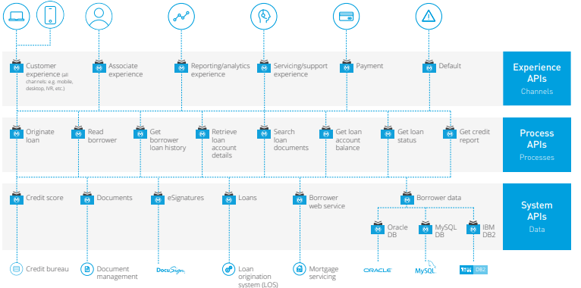
Solution Architecture
Below is an illustrative architecture of how Acme’s Pharma’s new Workday system will mirror. This illustrates the application network and a foundation for new HCM services.

Slide 10
Project Phases, Timeline and Resource Allocation
Week 1
Week 2
Week 3
Week 4
Week 5
Week 6
Week 7
Week 8
Week 9
Discovery and planning
Architecture and Design Platform
Implementation - Platform
Architecture and Design - Projects (Workday HRIS)
Implementation- Projects (Workday HRIS)
Deploy and Transition - Projects
C4E Foundation - Assess Organizational Capabilities
C4E Foundation - Establish C4E Operating Model
C4E Foundation - Measure C4E KPIs and refine
Develop internal support operating model
Talent Foundation
Resource Allocation:
Solution Architect Delivery Manager
Senior Consultant Delivery Manager
Solution Architect Senior Consultant Delivery Manager
Delivery Manager
Kick-off meeting
Deliverables
Status Reports

Slide 11
Project Delivery Assurance
Its critical you address the below.
You are going into a hot situation where the project is starting a bit late due to delays, but the timeline for delivery has not been changed. Your job is to convince them that you are the right person to get this on track and deliver successfully. How do you solve this problem?
As the PM, you need a daily meeting with relevant stakeholders to discuss project update. The plan is to be able to discuss and review project problems at the earliest and also be able to resolve them with the right contacts.
Vendor Contact (technical and business)
Project Contacts (Technical, Testers, business analysts, architects… etc)
Ensure vendor support are onsite.
Escalation contacts on both sides
Emergency Change Process – To cut timelines and delays to the project.

Slide 12
Risks and Issues
No | Risk Description | Likelihood | Impact | Mitigation Action
1 | Resource mobilization due to multiple projects | Medium | High | Setup weekly resource allocation call Procure outside resources if necessary
2 | Scope Creep | Low | Low | Refer to the project scope at every phase of the project and asses all changes against the baseline scope.
3 | Unplanned work that must be accommodated | Low | High | Document all assumptions made in planning and make plans for adjustments

Slide 13
Status Summary Dashboard
Overall Status: Amber
The work stream is currently reporting a Amber overall due to the lack of resource availability at the moment. This is now impacting the early stages of project implementation.
Assumptions
Completion of Workday migration.
Budget availability.
WorkDay Connector availability.
Progress Overview
Dashboard | PREV RAG | Current RAG | Commentary
Resource | G | A | Project resources has been heighted as a concern
Budget | G | G | Funding availability for the completion of the project
Plan/Schedule | G | A | Due to lack of resource availability project is behind by two weeks
Risks & Dependencies | G | A | Assumption is Workday Migration is complete, see risks below
Activities Completed this period | Activities planned for the next two weeks
Completion of project SOW Activities breakdown (WBS) | Develop team ( procure necessary resources needed) Finalize Hardware procurement Finalize InfoSec Agreement
Risks | Impact | Mitigation
Resource | High | Schedule a resource escalation call
Scheduling | Medium | Work on multiple activities simultaneously

Slide 14
Decisions and Next Steps
Steering Committee Approval Required
Approval to procure outside resources if required
Next Steps | Expected Outcome | Responsibility | Due Date
Schedule a resource escalation call with the resource managers to understand resource availability and request priority. | Get resource allocation prioritized and onboarded | Delivery Manager | Tuesday, 26th Nov 2019
Schedule a meeting with the InfoSec team to discuss InfoSec agreement needs | Understand the status of the agreement and agree with the team to get it finalized | Delivery Manager | Tuesday, 26th Nov 2019
Finalize and acquire required hardware (Servers) | Hardware is ready | Delivery Manager | Monday, 2nd Dec 2019
Notes:
List next steps until the next Steering Committee meeting.

Slide 15
Questions
Questions?

